Slide 1
Tog Coders Night 1#
About C Language
By Paul McQuade <paulmcquad@gmail.com>
Twitter: @paulmcquad
https://github.com/paulmcquad/Tog-Coders-Night

Slide 2
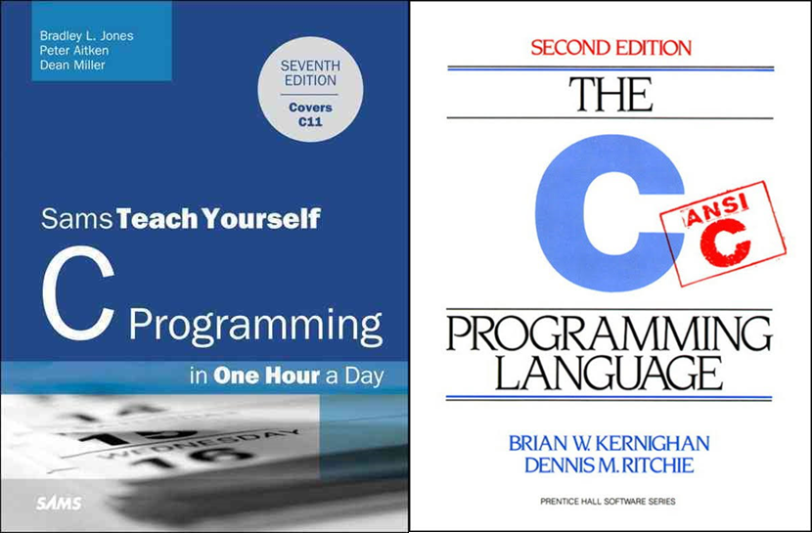
C Programming Books
The C Programming Language 2nd Edition
ISBN-13: 978-0131103627
C Programming in One Hour a Day, Sams Teach Yourself (7th Edition) 7th Edition
ISBN-13: 978-0789751997

Slide 3
Why use C?
Short Answer:
C is powerful and flexible language
C is a popular language
C is a portable language
C is modular
Long Answer:
C compiles down to machine code and doesn't require any runtime support for the language itself. This means that it's possible to write code that can run before things like filesystems, virtual memory, processes, and anything else but registers and RAM exist.

Slide 4
Why C is better than C++?
Linus Torvalds on C++
http://harmful.cat-v.org/software/c++/linus
Why would anybody use C over C++?
https://stackoverflow.com/questions/497786/why-would-anybody-use-c-over-c

Slide 5
What next?
Check out some of my C programs: Tog-Coders-Night\CODE\C
Compile the code:
Create an account on Github/ Bitbucket/ Sourceforge etc.
Write some basic programs:

